Slide 1

Hospital Quarterly Financial Utilization
Mentored By
Mr. Kunal Kumar nath
Mr.Gandam Pranay Kumar

Slide 2


Our Team
Mamatha K N
Tarun Vidagotti
Gayatri Balaji Aurande
Anshu Bhardwaj
Chetana Subhash Gawande

Slide 3
Introduction
This presentation provides a quarterly overview of hospital financial utilization, focusing on key performance indicators such as Total Discharges, Patient Days, and Net Patient Revenue.
It highlights year-to-date (YTD) and quarter-to-date (QTD) trends, state-wise hospital distribution, and overall counts of hospitals, doctors, and patients.
It analyzes revenue contributions based on hospital types to support data-driven decision-making.

Slide 4
Dataset Description
This dataset captures quarterly financial and operational data from hospitals. It includes facility details, operational status, bed availability, and key performance metrics such as:
Total Discharges(DIS_TOT)
Patient Days(DAY_TOT)
Net Patient Revenue(NET_PAT_REV_CC)
Quarter/Year Indicators(YEAR_QTR, Year, Quarter)
Hospital Type and Ownership(TYPE_HOSP, TYPE_CNTRL)
Facility Location and Country(COUNTRY_NAME, CITY, STATE)
Total Hospitals, Doctors, and Patients(derived from counts and summery metrices)

Slide 5
KPI Analysis
Patient Days
Total Discharge
Net Patient Revenue
KPI
Total Patient, Total Doctor, Total Hospital
State Wise No of hospital/
Revenue
YTD/QTD
Type of Hospital Revenue

Slide 6
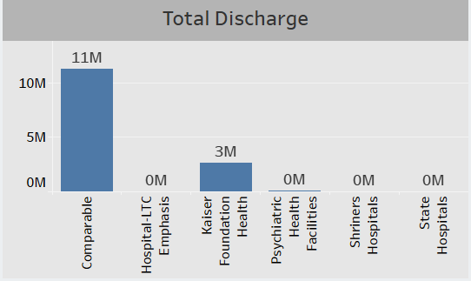
Total Discharges
The highest number of discharges occurred in Comparable hospitals.
Kaiser Foundation Health contributed a smaller portion of discharges.
Other hospital types, including Psychiatric Facilities, State Hospitals, and LTC Emphasis, had minimal discharge activity.
This distribution suggests that patient discharge activity is heavily concentrated in specific hospital categories.

Slide 7
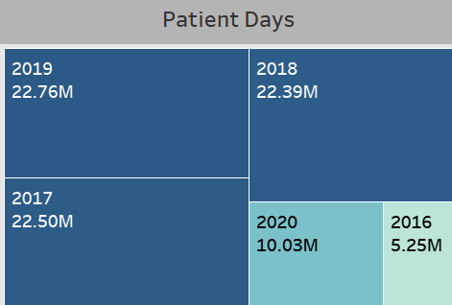
Patient Days
Patient days peaked in mid-years and declined in the most recent year.
Comparable hospitals had the highest share of patient days across all years.
A consistent trend was observed from year to year, with slight fluctuations.
The recent decline may suggest changes in hospital stay durations or patient volume.

Slide 8
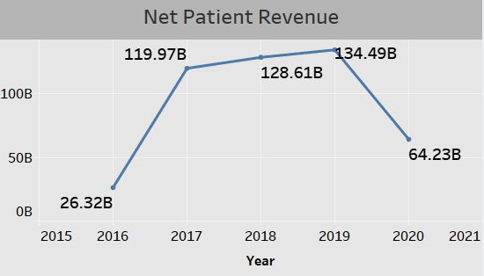
Net Patient Revenue
Net patient revenue showed a steady increase over the years until a noticeable drop in the most recent year.
The revenue growth trend indicates improved financial performance before the decline.
The recent dip may reflect reduced patient volumes, shorter stays, or changes in billing.
Highlights the importance of monitoring revenue drivers and operational efficiency.

Slide 9
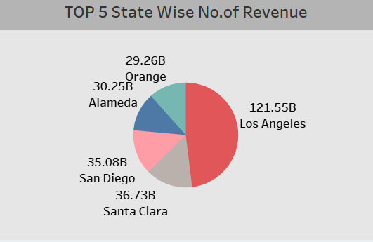
State wise no. of hospital/revenue
Los Angeles leads significantly in hospital revenue contribution.
Santa Clara and San Diego follow, showing strong financial performance.
Alameda and Orange also rank in the top five but contribute comparatively less.
The chart highlights geographic concentration of revenue, with Los Angeles generating nearly half of the total.

Slide 10
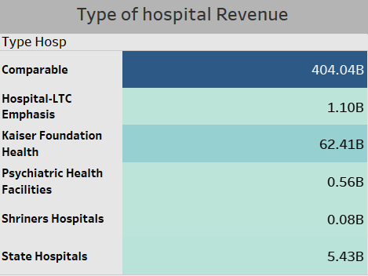
Type of hospital revenue
Comparable hospitals generate the highest revenue by a large margin.
Kaiser Foundation Health contributes significantly but still far behind comparable.
Other hospital types (e.g., State Hospitals, LTC Emphasis, Psychiatric, and Shriners) show minimal revenue impact.
The data reflects a concentration of financial performance in specific hospital categories.

Slide 11
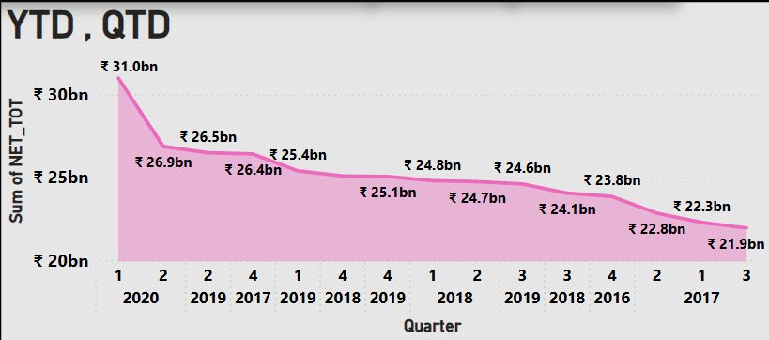
YTD/QTD
Net patient revenue peaked in Q1 2020, followed by a consistent decline across subsequent quarters.
The decreasing trend suggests potential drops in patient volume, billing efficiency, or operational throughput.
It Highlights the need to analyze contributing factors behind declining quarterly revenues over time.

Slide 12
Total patient, Total Doctor, Total Hospital
A large number of patients have been served across a wide hospital network.
The system supports thousands of hospitals, indicating strong infrastructure coverage.
A high volume of doctors highlights robust medical staffing and capacity to handle patient demand.

Slide 13
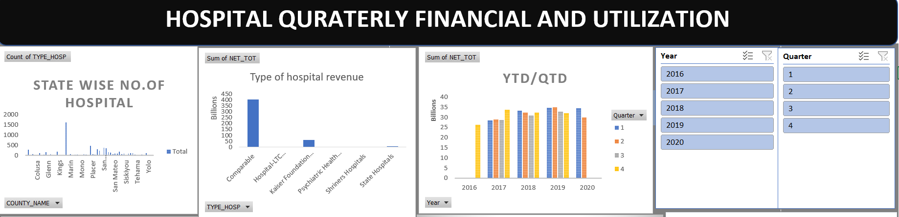
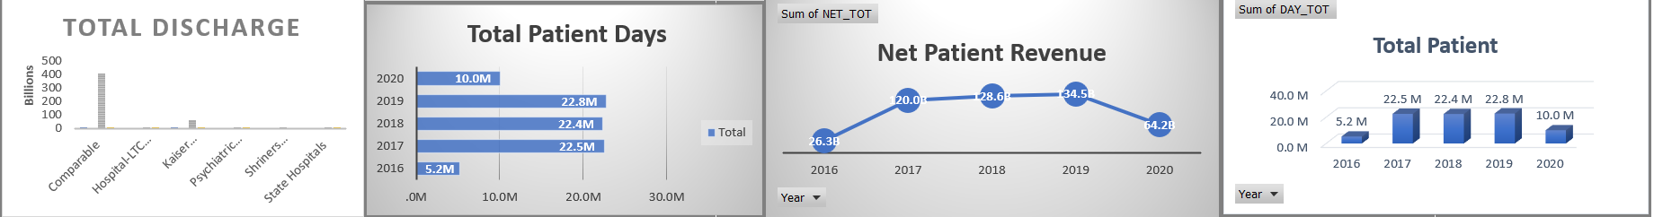
Excel Dashboard

Slide 14
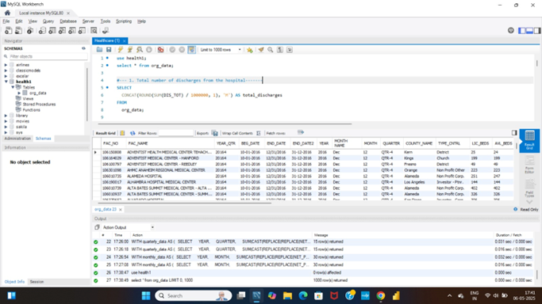
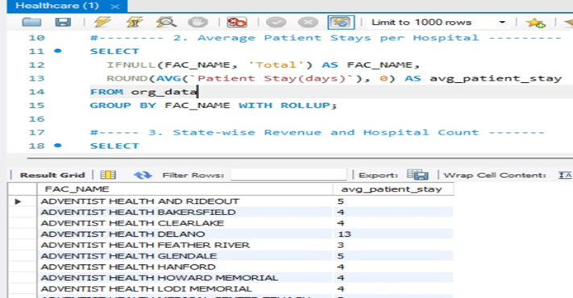
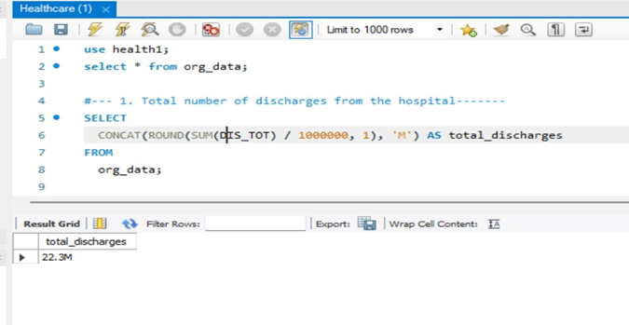
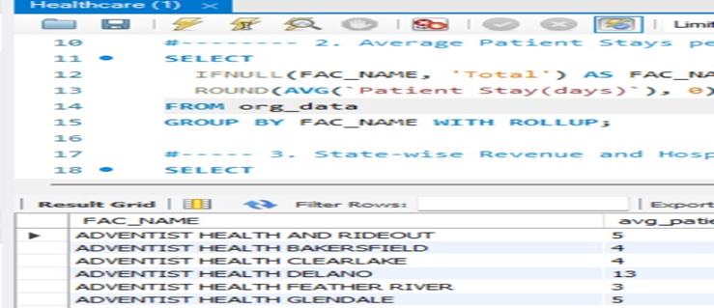
SQL Queries

Slide 15
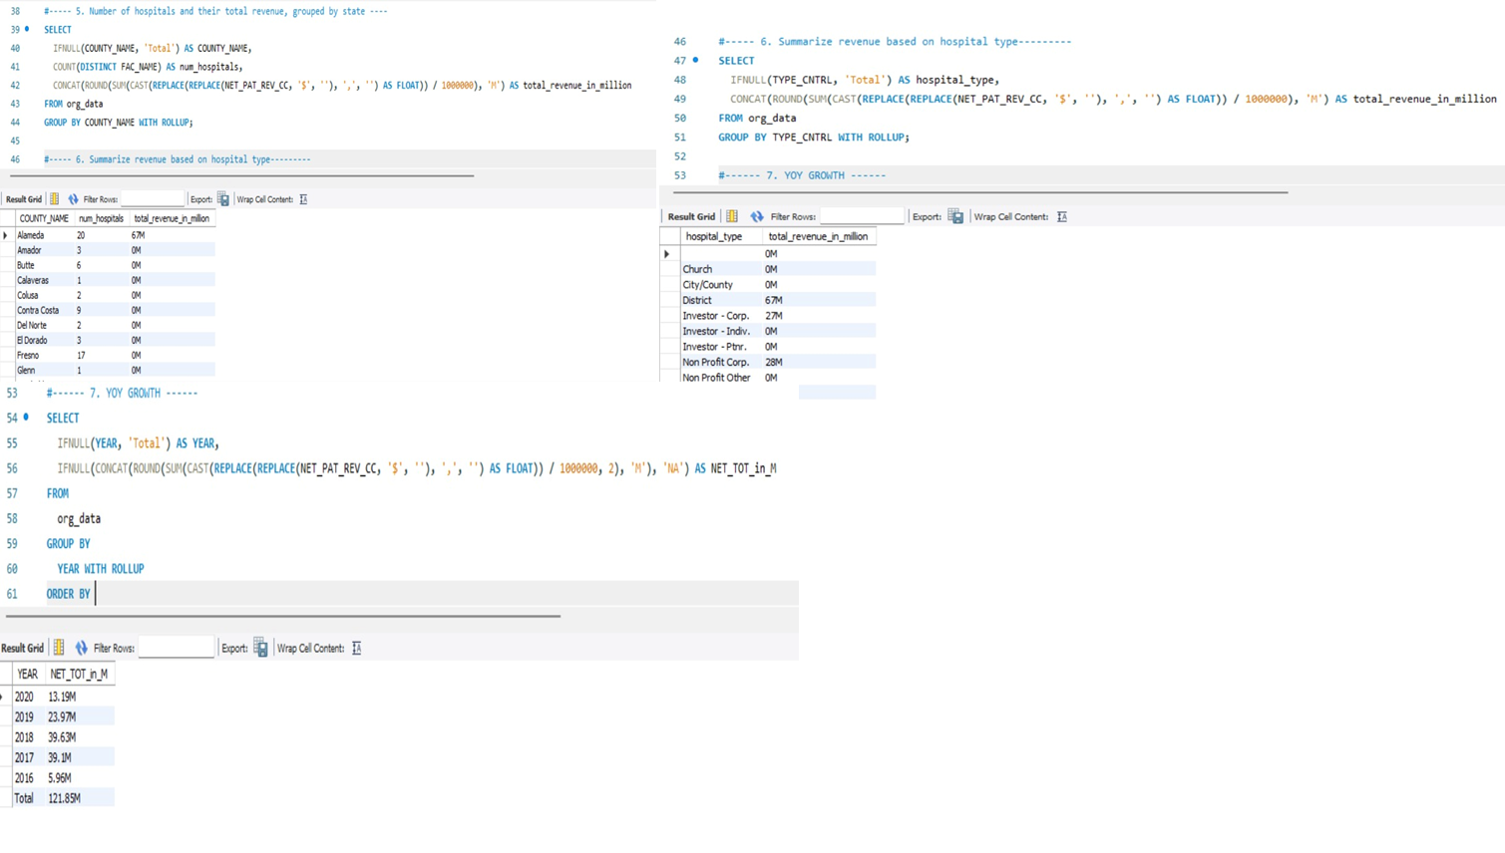
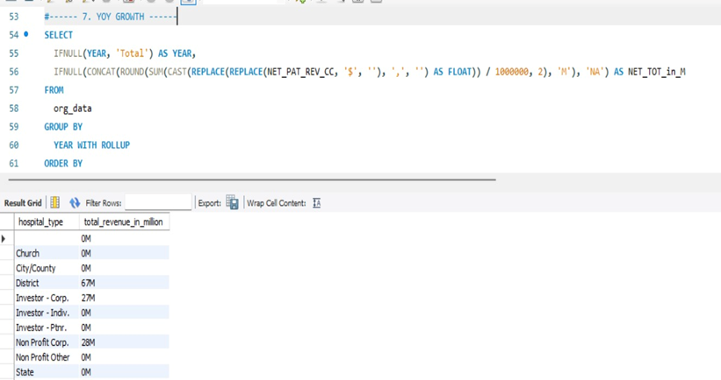

Slide 16
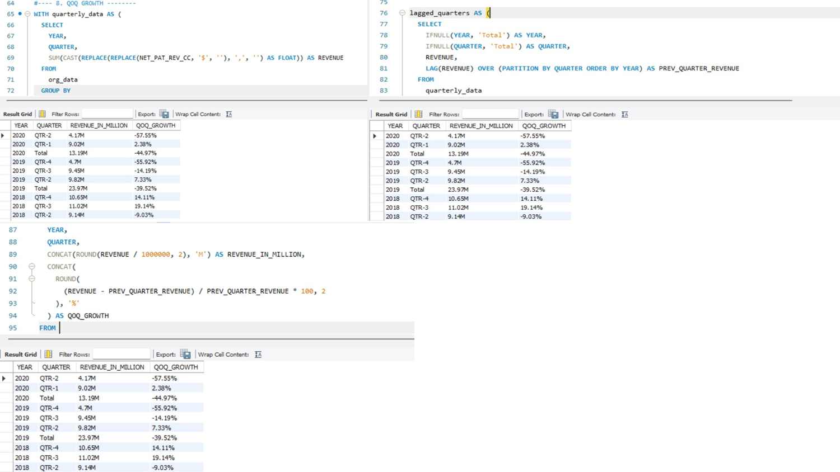
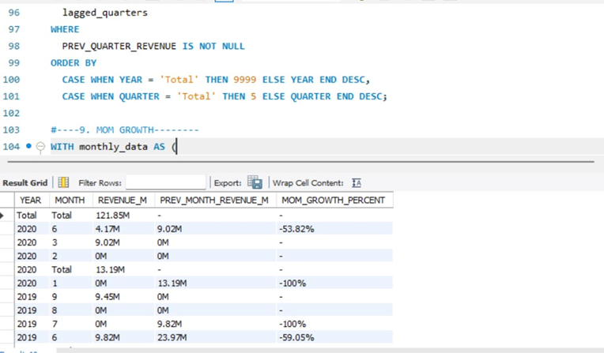

Slide 17
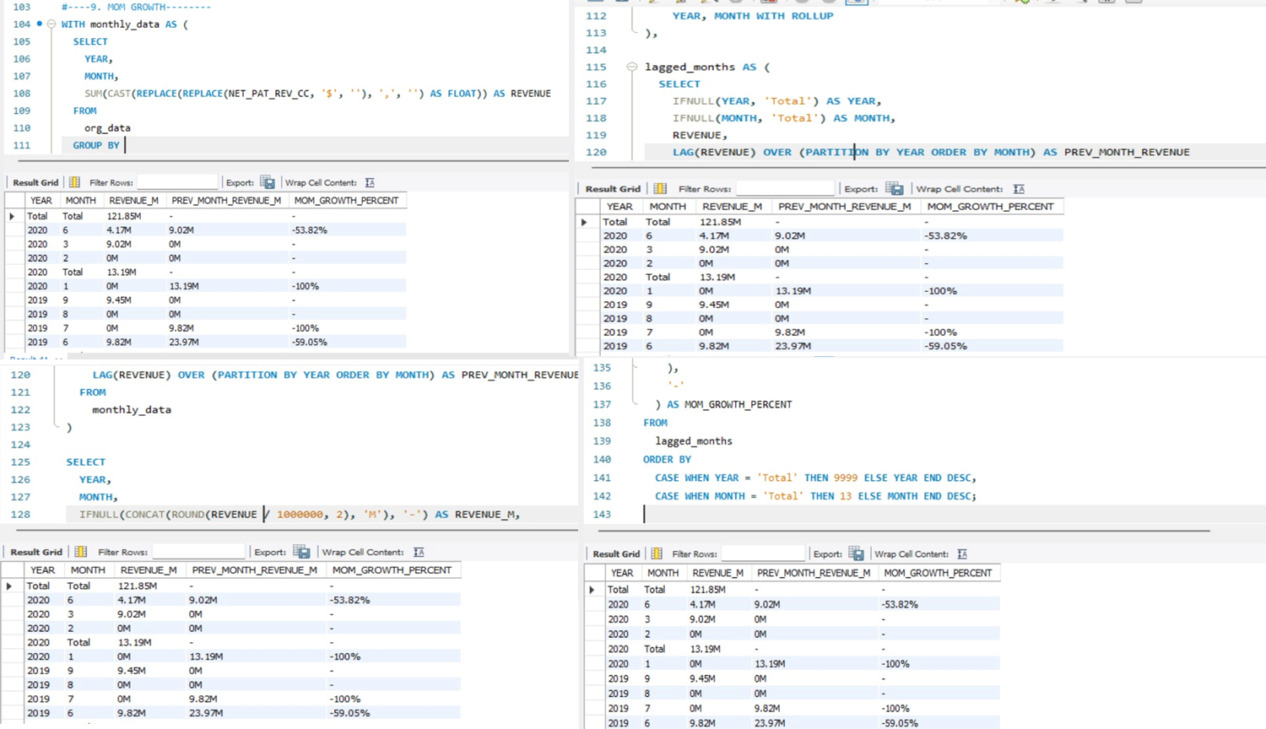

Slide 18
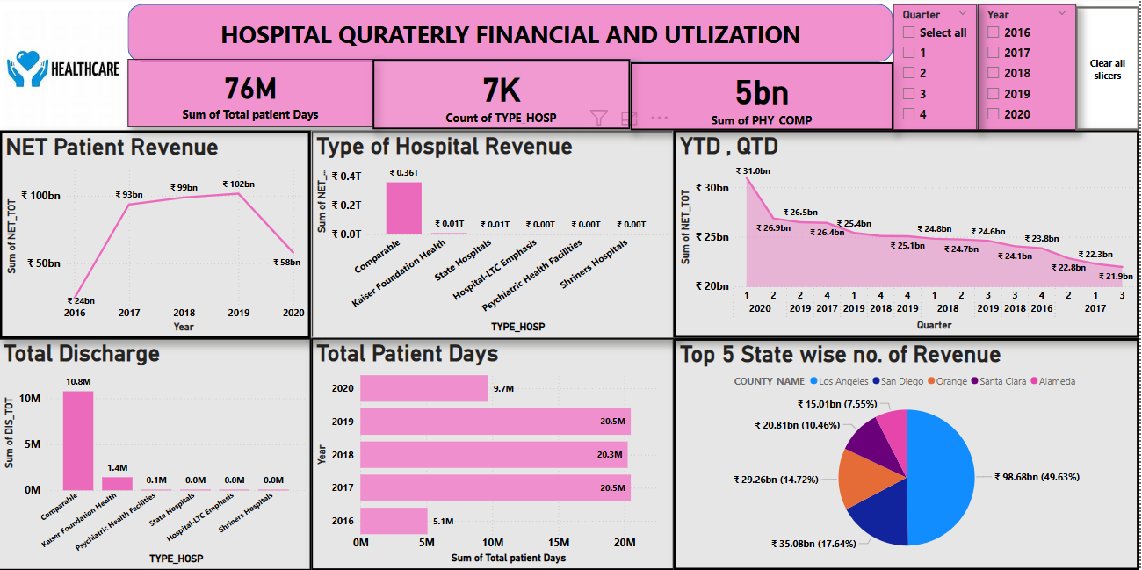
Power BI Dashboard

Slide 19
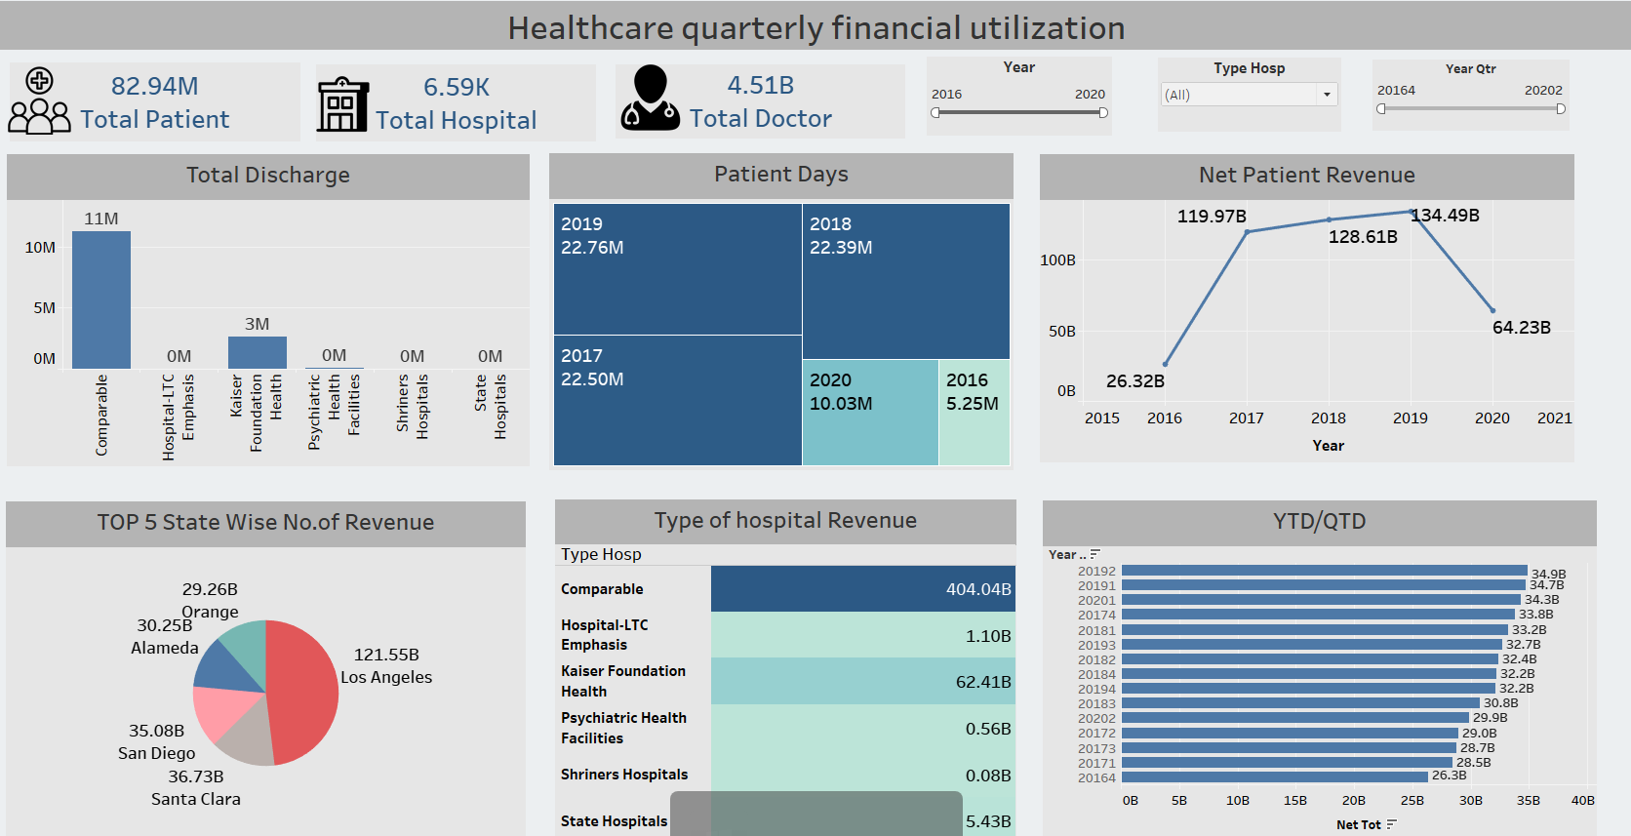
Tableau Dashboard

Slide 20
Challenges
derive new fields like quarter, month, and year from End Date
Calculating KPIs with accurate logic was essential to avoid misleading metrics
Aligning data between Excel, Power BI, and Tableau required consistent formatting and cleanup.
Needed to Date fields were in inconsistent text format, causing formula and charting errors.

Slide 21
Thank You

